Slide 1

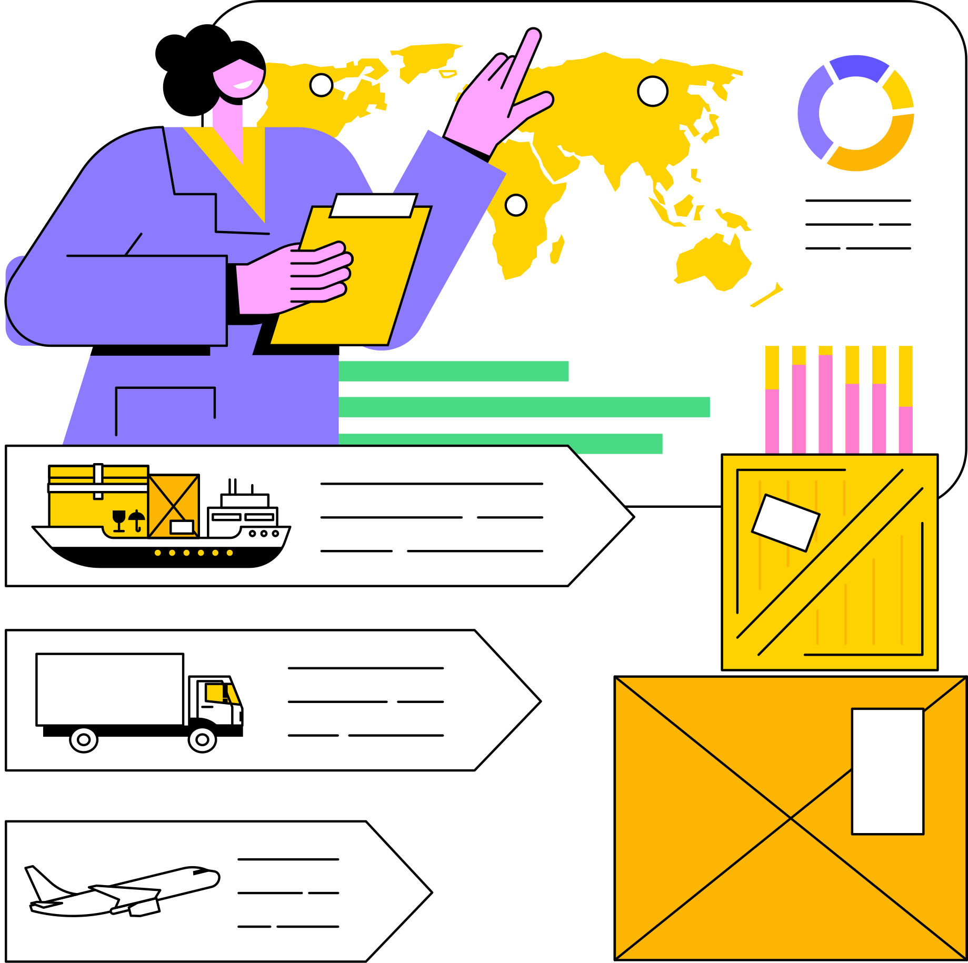

Team #4
SUPPLY CHAIN ANALYTICS
Using: Excel, Python & PoweBi
Presented By : Ahmed Mohamed , Mostafa Abdellatif , Norhan shoukry,Y assmin Sayed

Slide 2


Supply Chain Analytics Presentation ..............................................................
TABLE OF CONTENT
01
02
03
WHAT’S SUPPLY CHAIN?
INTRODUCTION
DATA CLEANING
04
05
INSIGHTS
FUTURE PLAN

Slide 3

Supply Chain Analytics Presentation ..............................................................
WHAT IS SUPPLY CHAIN ?
A supply chain is a network of organizations, people, activities, information, and resources involved in the production and delivery of a product or service from the initial supplier to the final customer. It encompasses everything from sourcing raw materials, manufacturing, and transportation to warehousing, distribution, and customer service. An efficient supply chain ensures that products are delivered in the right quantity, to the right place, at the right time, while minimizing costs and maximizing customer satisfaction.

Slide 4
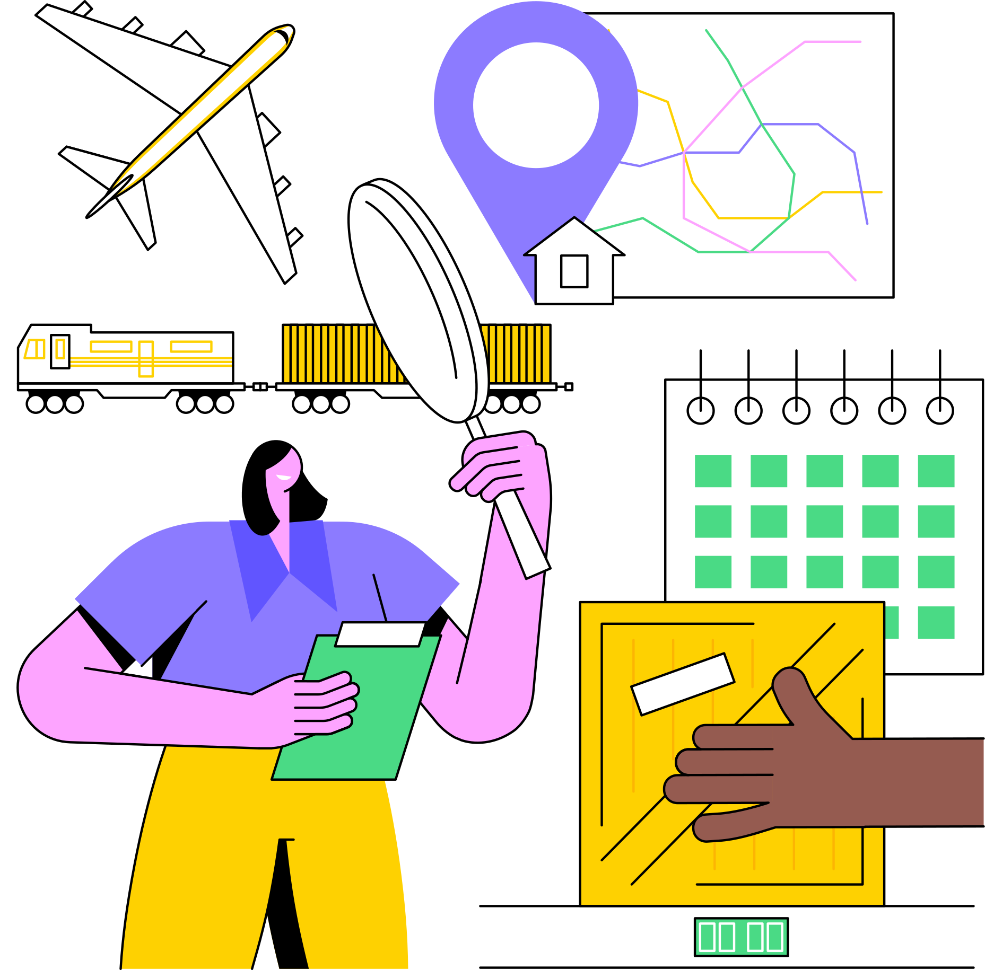
Supply Chain Analytics Presentation ..............................................................
INTRODUCTION
The primary objective of this project was to gain a comprehensive understanding of global product consumption patterns and to identify strategic opportunities for expansion in both production and sales operations.
Through advanced data analysis, we aimed to track and quantify product demand across different regions by identifying the countries with the highest import volumes and analyzing corresponding sales performance.
By uncovering these insights, the goal was to support data-driven decisions for scaling production capacity, optimizing inventory distribution, and enhancing market penetration in high-performing regions.

Slide 5

Supply Chain Analytics Presentation ..............................................................
DATA CLEANING
In this data analysis project, data cleaning was performed using Python and Excel to prepare the dataset for accurate analysis. Python libraries such as Pandas were used to automatically remove rows containing None (missing) values and to identify and drop duplicate entries. Additionally, Excel was used for manual inspection and correction of customer demographic fields, such as standardizing age groups, fixing inconsistent gender entries, and removing irrelevant or outlier data. This combined approach ensured the dataset was clean, consistent, and ready for analysis.
NONE VALUES
DUPLICATES
CUSTOMER DEMOGRAPHICS

Slide 6
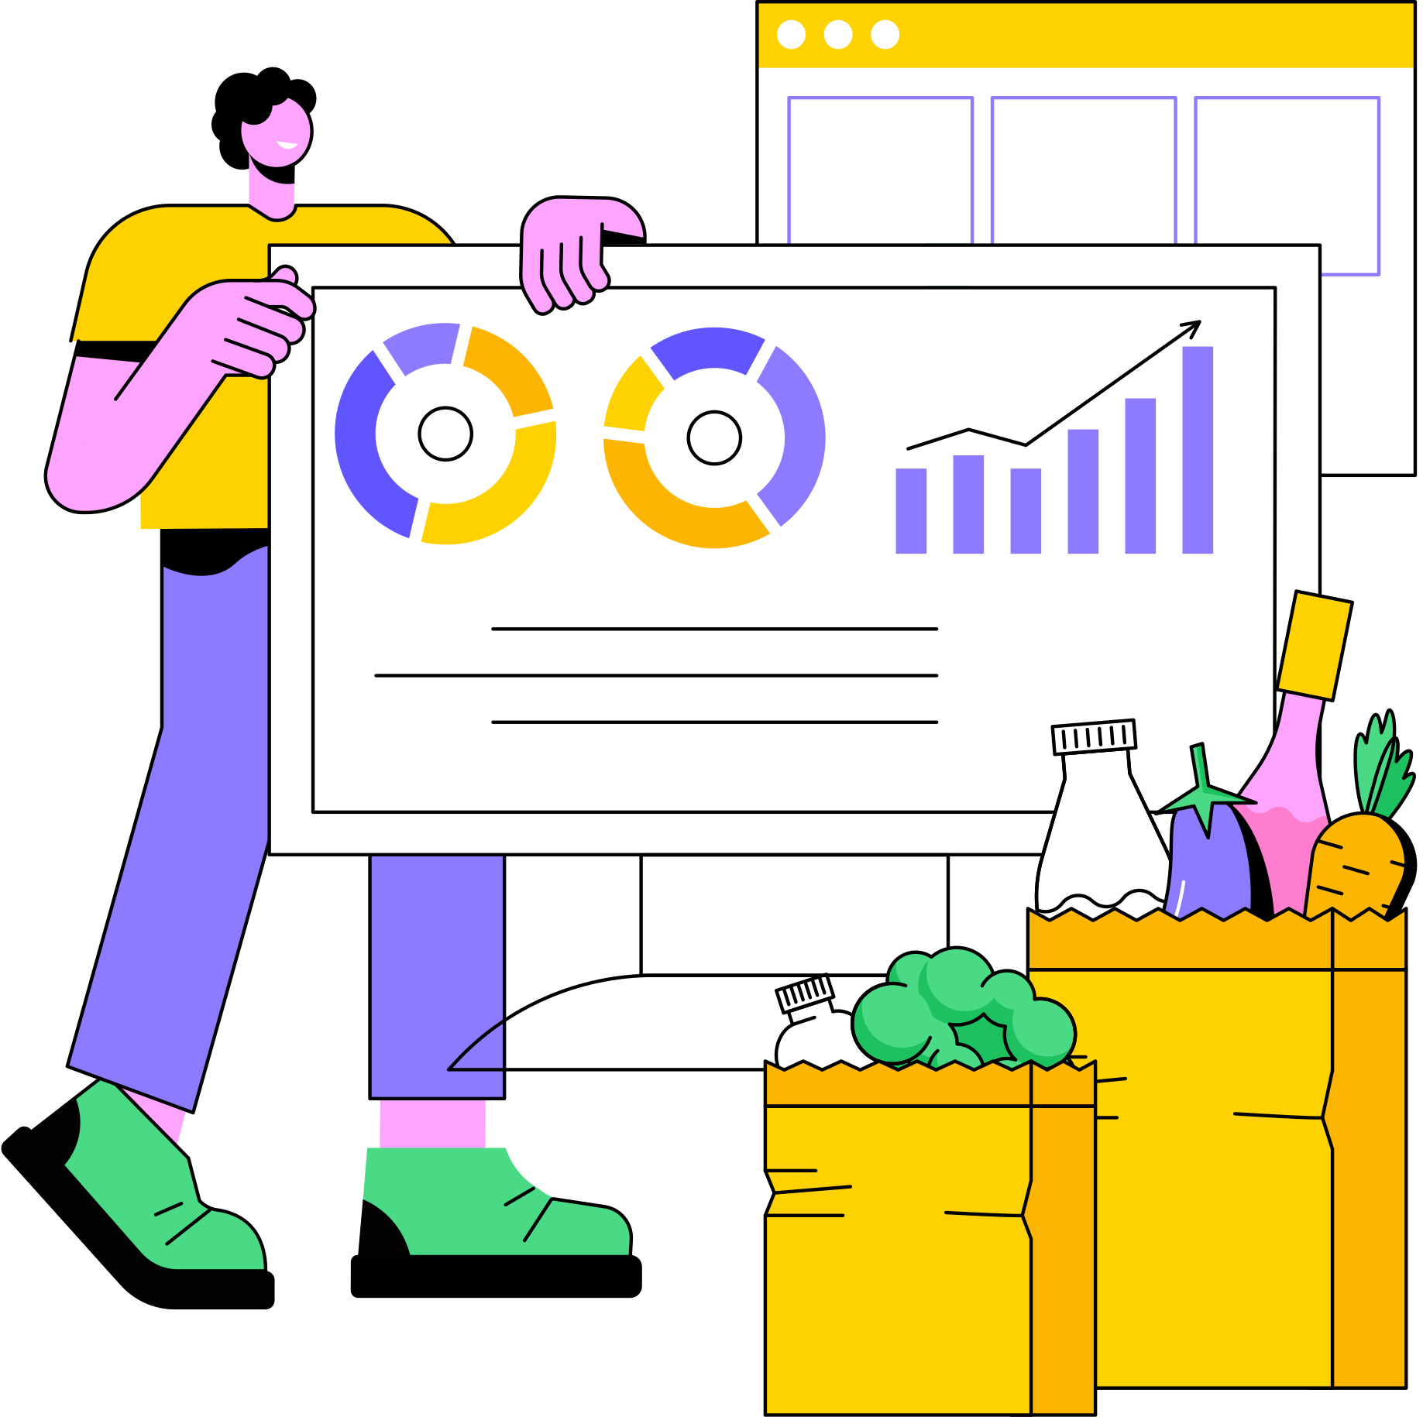
Supply Chain Analytics Presentation ..............................................................
DATA MODELLING & VISUALIZATION
In this project, Power BI and SQL were used together to build robust data models and create interactive visualizations. SQL was employed to extract, transform, and aggregate data from relational databases, enabling efficient data preparation and filtering at the source. The cleaned and structured data was then imported into Power BI, where data relationships were defined, calculated fields were created, and intuitive visualizations were built to uncover trends and insights. This integration allowed for dynamic dashboards and real-time reporting, enhancing decision-making through clear and actionable visual representations of the data.

Slide 7
Supply Chain Analytics Presentation ..............................................................
BENEFITS OF SUPPLY CHAIN ANALYTICS
COST REDUCTION
Minimize waste and reduce operational costs.
Implementing supply chain analytics leads to significant cost reductions by identifying bottlenecks and inefficiencies. The ability to make data-driven decisions in real-time allows for faster responses to changing market conditions and improved customer satisfaction. Making data-driven decisions in real-time leads to faster responses to changing market conditions and improved customer satisfaction.
IMPROVED DECISION-MAKING
Providing real-time insights to make data-driven decisions
ENHANCED CUSTOMER SATISFACTION
Predicting demand more accurately

Slide 8
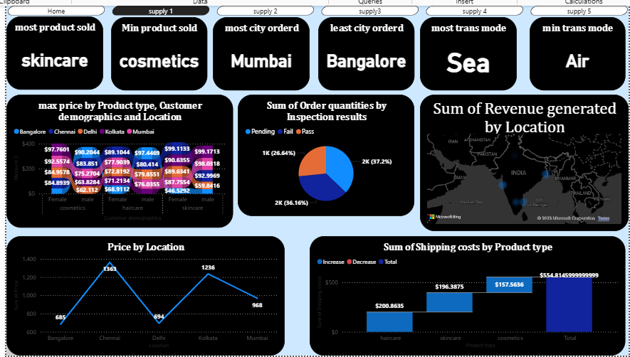

Slide 9
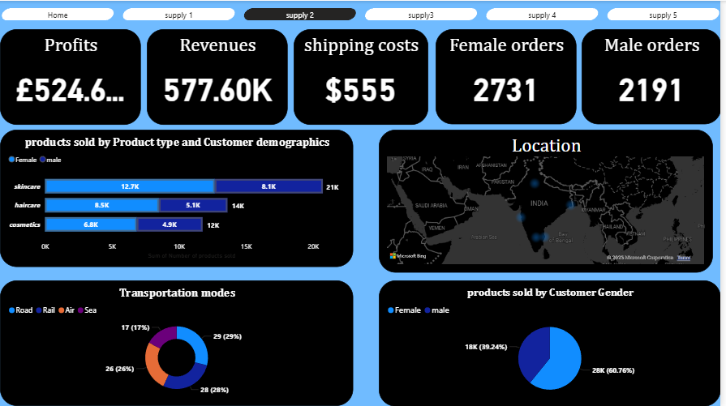

Slide 10
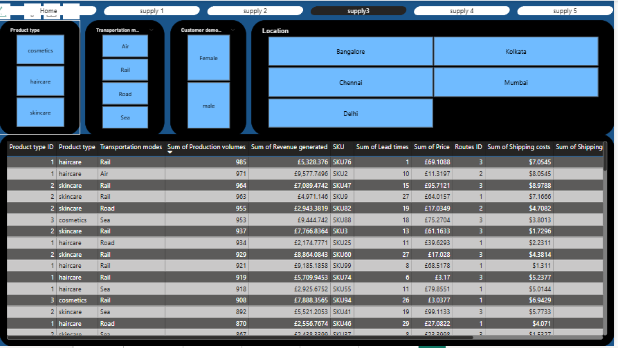

Slide 11
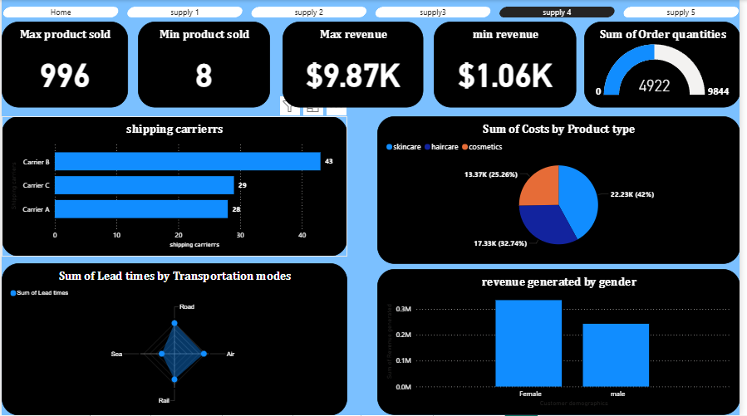

Slide 12
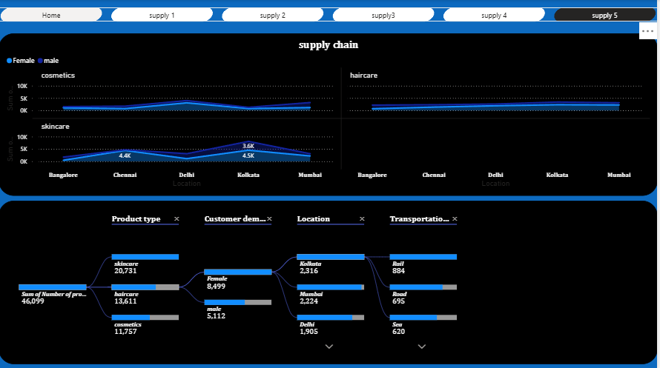

Slide 13
Supply Chain Analytics Presentation ..............................................................
FUTURE TRENDS IN SUPPLY CHAIN ANALYTICS
DYNAMIC PRICING OPTIMIZATION
Maximize revenue by adapting prices based on demand
AI AND MACHINE LEARNING
BLOCKCHAIN TECHNOLOGY
IOT INTEGRATION
Increasingly sophisticated models
Enabling transparency and traceability
Using sensor data for real-time tracking

Slide 14
Giggling Platypus Co.
THANK YOU
Take the Next Step Toward a Data-Driven Supply Chain
For More Information : www.reallygreatsite.com

